Slide 1
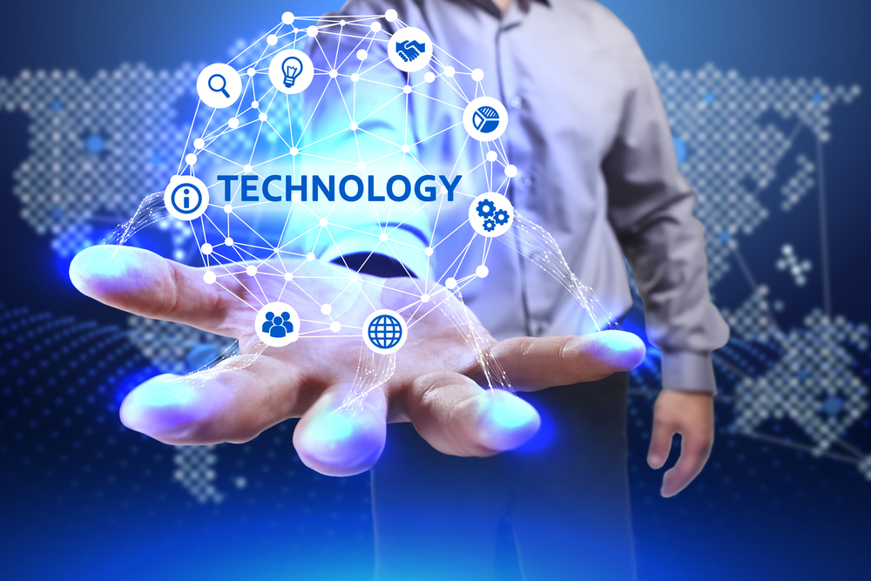
PIC 2023 Hackathon
Hacking Healthcare: Empowering Better Care Delivery
Fuchsia Fighters
Idea | Skin Cancer Detection Application – “DermaVision”
Theme | Expand Use of AI/ML
Team members | Aditya Tomar Ramesh Mogalluri Manali Hundalekar Sadiya Aslam Shikhar Malik

Slide 2
Idea / Problem Statement
Nearly one in five people develop skin cancer sometime in their life. Nearly all skin cancers can be cured if found and treated early. Treatments include excision, cryotherapy, chemotherapy and radiation.
Other skin cancer facts:
Around 20% of Americans develop skin cancer sometime in their life.
Approximately 9,500 Americans are diagnosed with skin cancer every day.
Having five or more sunburns in your life doubles your chance of developing melanoma. The good news is that the five-year survival rate is 99% if caught and treated early.
We propose to develop a Skin Cancer Detection System, which will be called “DermaVision”. It will make it readily accessible for the users to detect and reach out for help as soon as possible. In order to develop the project, we aim to build a machine learning predicting model along with an integrated web application to make the application convenient to use.

Slide 3
Process Flow
User can register with the application using the enroll button or directly login with their email & password. This is achieved through java springboot backend.
They can upload a photo to test what kind of skin disorder they might have. On pressing the upload button a request is sent to the python backend.
Our 2 machine learning models trained on two different datasets process the uploaded image and provide results in percentages of various skin disorders they can detect.
An electronic copy of the result displayed is sent to the user as an email through python backend.
At the end the user can choose to connect with a health care provider affiliated with the UHG network and the customer care representatives reach out to them so the user they can book an appointment.

Slide 4



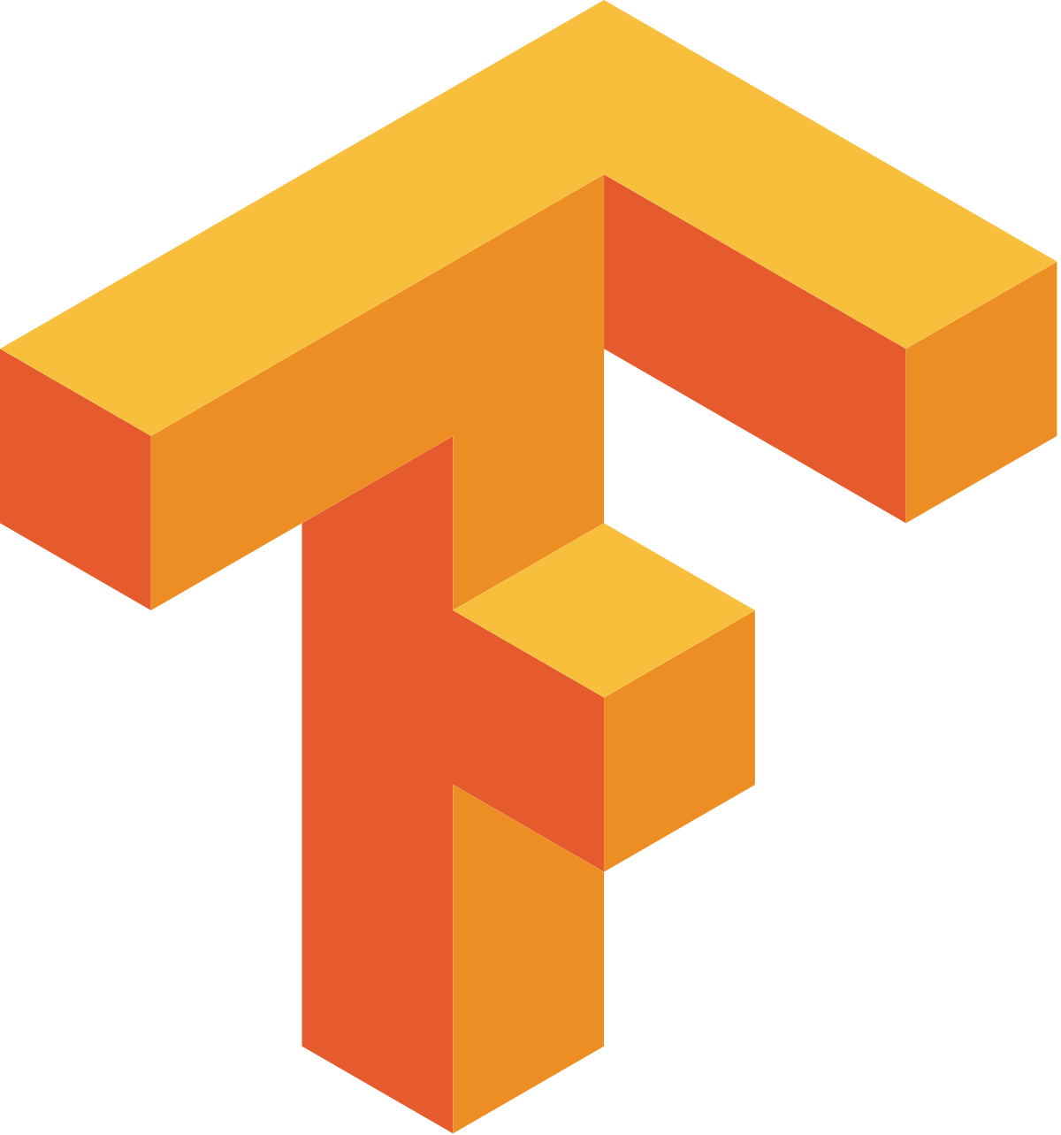

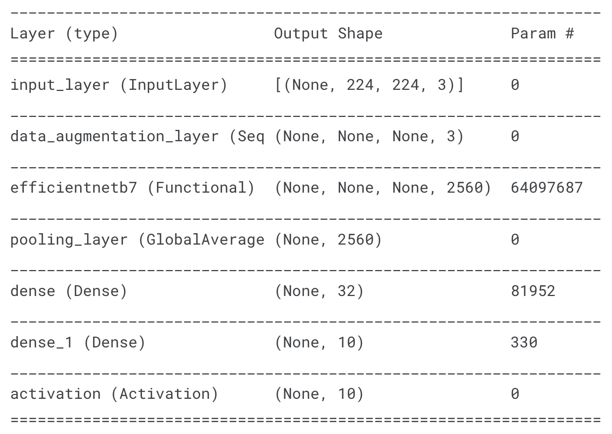
Implementation Details
Tech Stack
Python - Numpy, Keras, Tensorflow, Flask, Smtp
Java - Springboot, H2 Database
Javascript – React
Machine Learning Model Architecture
We have used EfficientNetB3 and EfficientNetB7 to train our models on 2 different skin disorder datasets.
Here we have a model summary of one of our models ->

Slide 5
Implementation Details
Datasets
We have trained two machine learning models on these datasets. The first dataset specializes in skin cancer categories while the second one is more generalized containing common skin diseases as well.
ISIC skin disease image dataset (10 GB, 25.3k images)
Actinic keratosis
Basal cell carcinoma
Benign keratosis
Dermatofibroma
Melanocytic nevus
Melanoma
Squamous cell carcinoma
Vascular lesion
Skin diseases image dataset (6 GB, 27.2k images)
Eczema
Warts Molluscum
Atopic Dermatitis
Basal Cell Carcinoma
Melanocytic Nevi
Benign Keratosis
Psoriasis pictures Lichen Planus
Seborrheic Keratoses
Tinea Ringworm Candidiasis
Melanoma

Slide 6
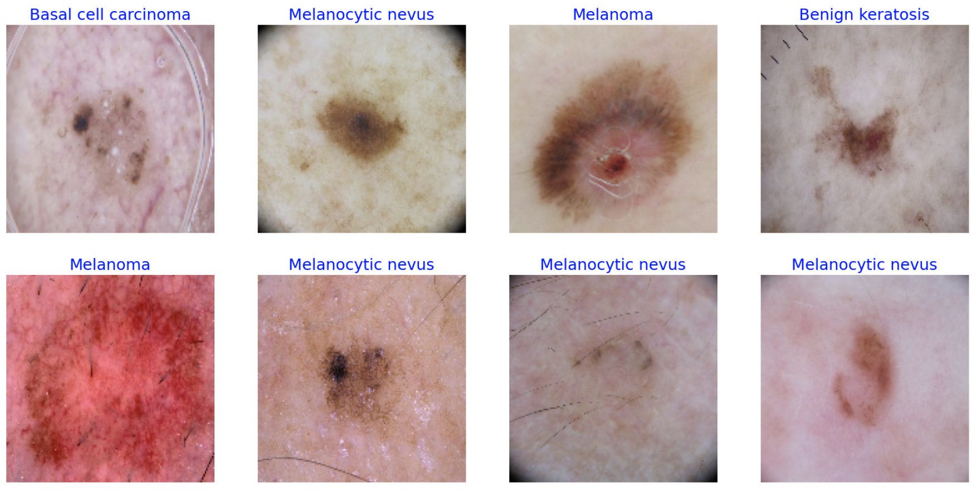
Implementation Details
Image Samples from the dataset

Slide 7
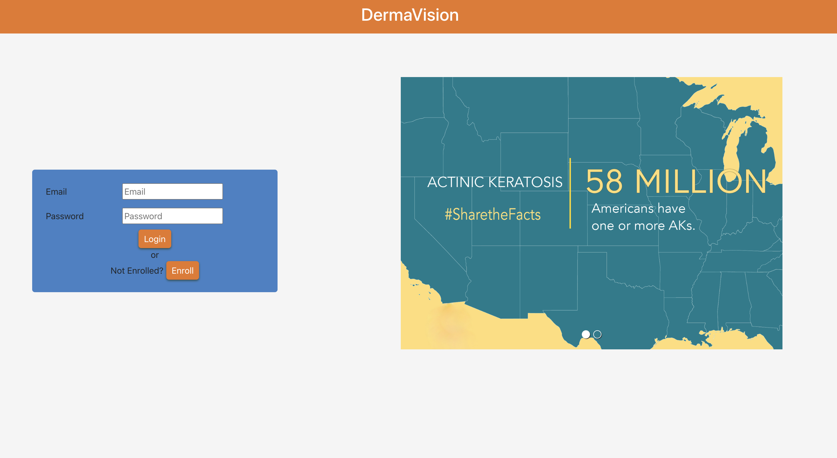
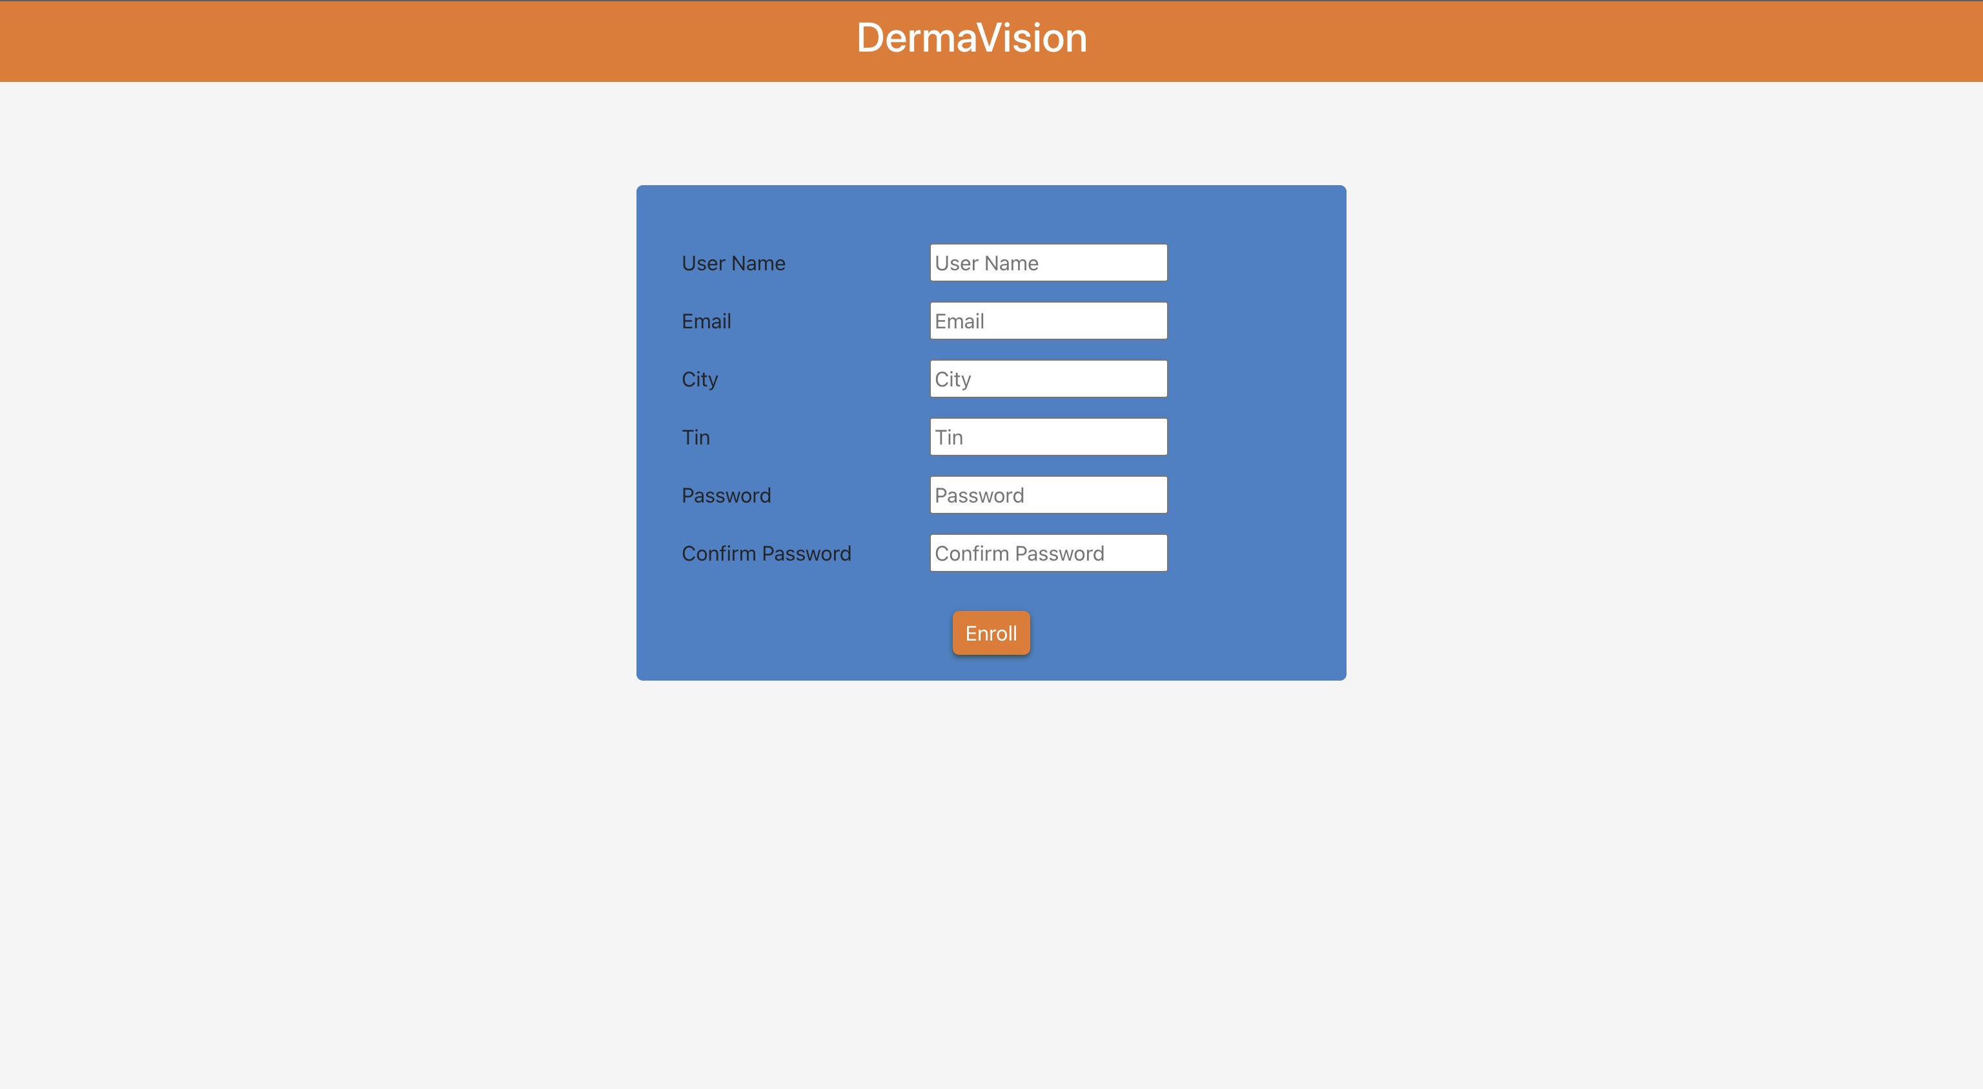
Implementation Details
Web Based Application
Login Authentication
Register User

Slide 8
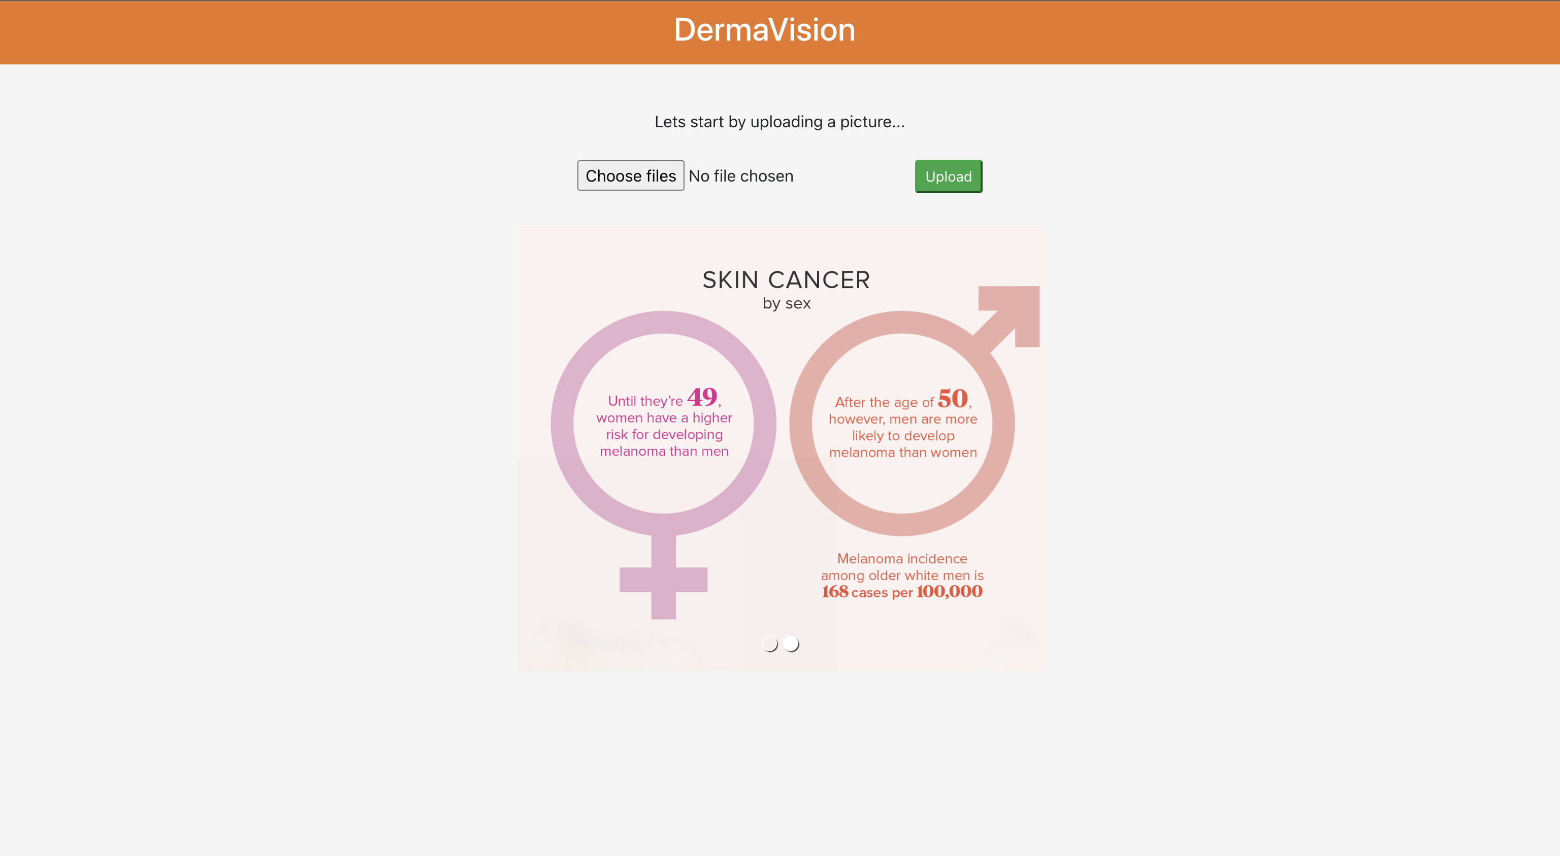
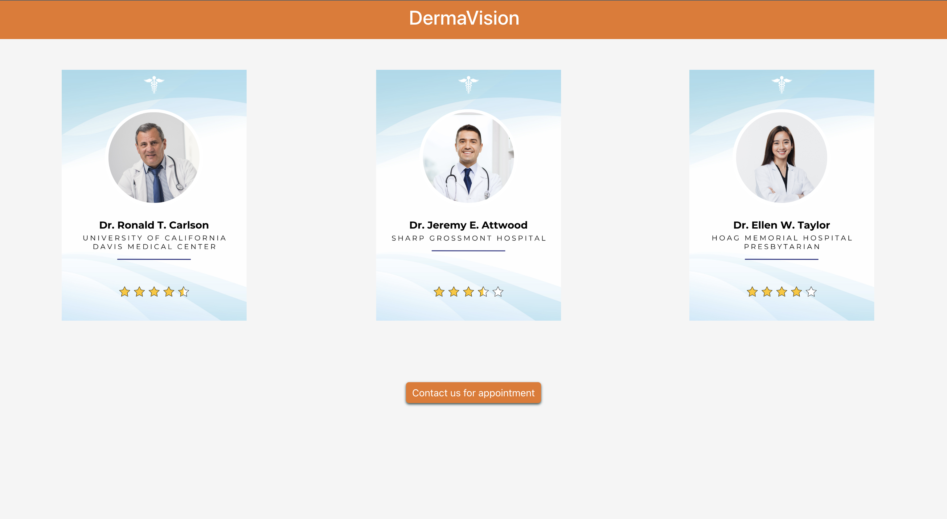
Implementation Details
Web Based Application
Upload Image
Contact Help

Slide 9
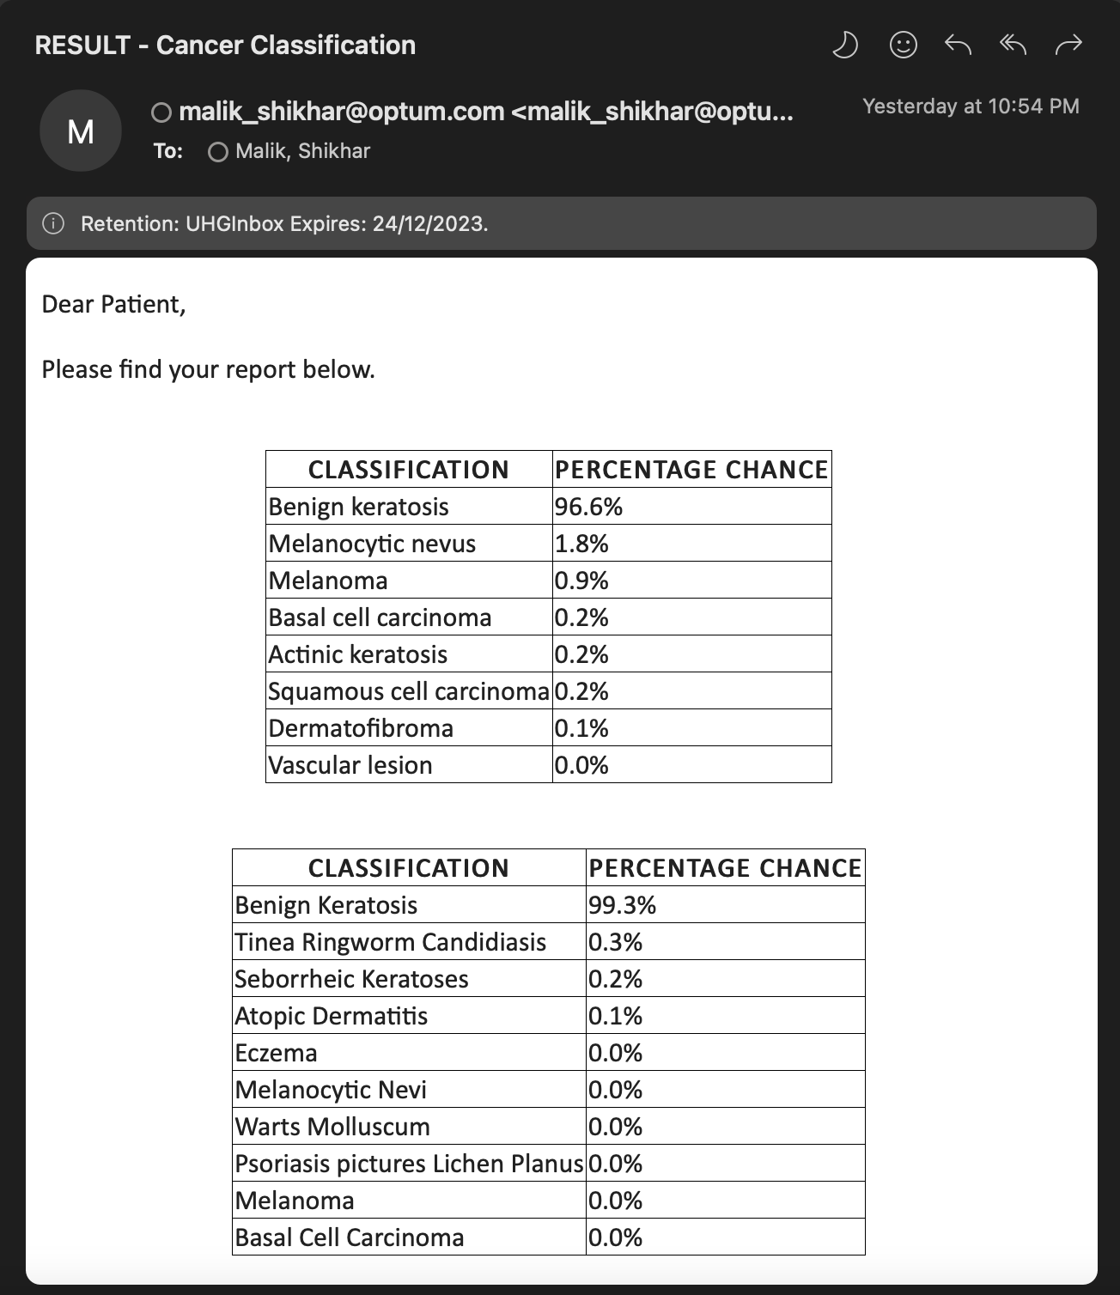
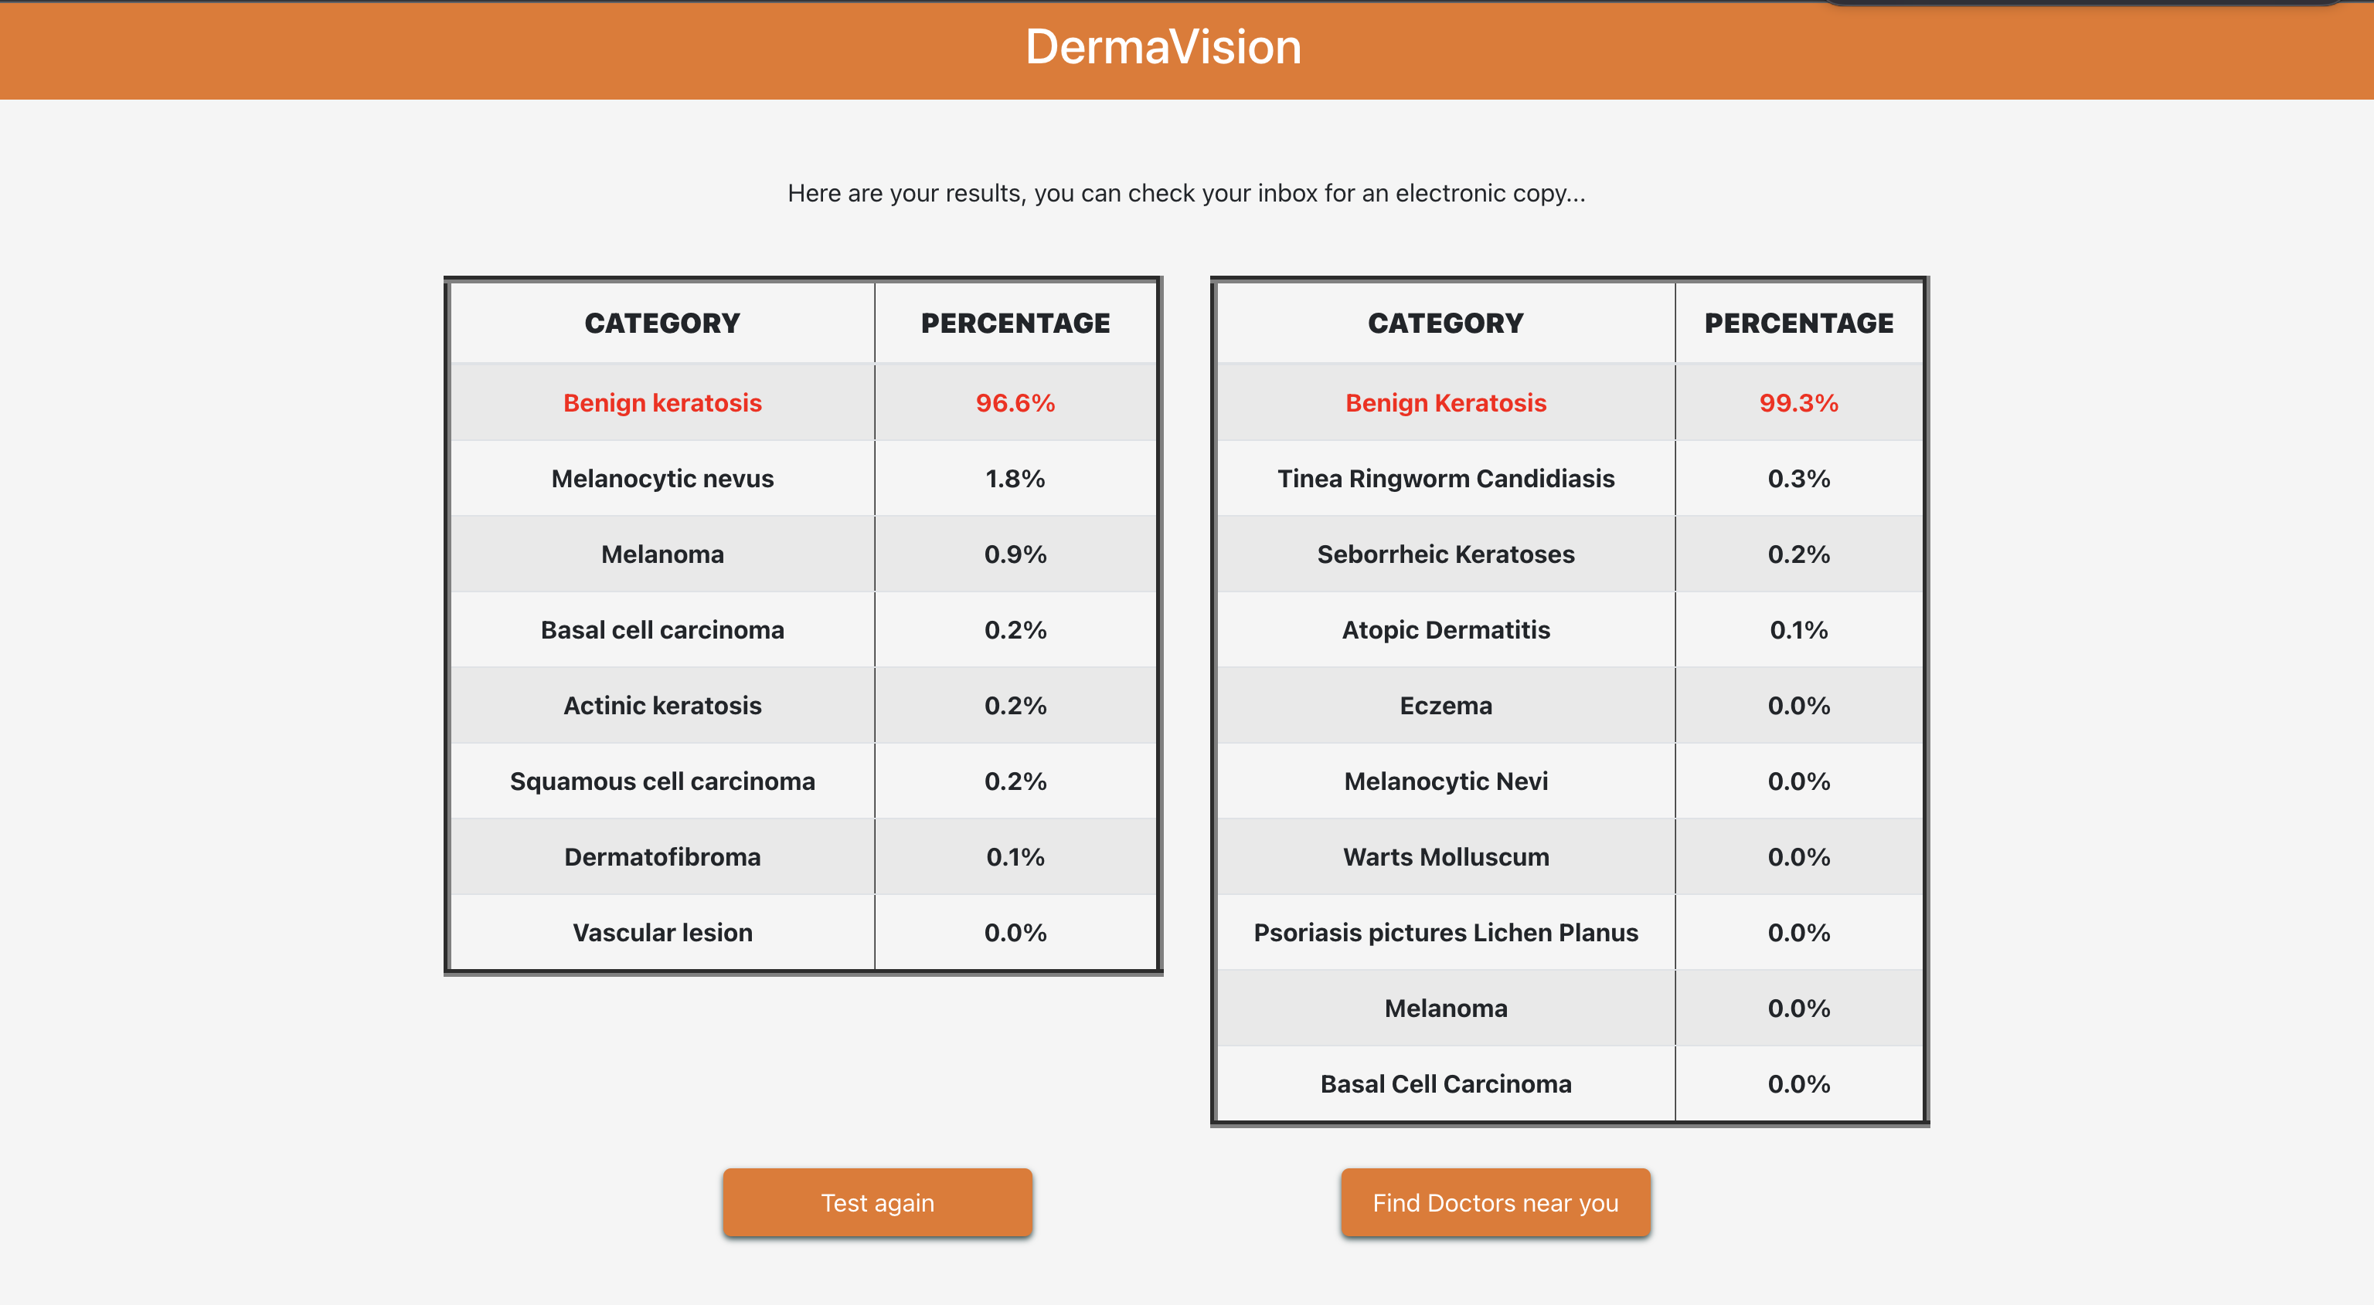
Implementation Details
Web Based Application
Result
Electronic Copy of Result

Slide 10
Proposed benefits
One of the major factors to take into account is the early detection of the skin cancer, because of which the doctors can come up with a treatment plan faster and since its detected fast it can lead to better recovery chances.
Healthcare providers suggested in the end are part of UHG network and they can be suggested according to the user’s location and preference. This helps the user get instant support based on the providers available.
U.S. Healthcare facilities generate nearly two billion pounds of paper and cardboard waste every year. Being part of the paperless team, we are encouraging the Electronic Paperless Initiative. So along with attempting to assist in the lives of people suffering from such a deadly disease like Cancer, we added a functionality to share result with the patient directly over email communication as soon as the tests are completed.

Slide 11
Feasibility
The application can be used to connect users with providers. This allows the providers to be connected with the concerned patients. With early detection it provides both the doctors and the users with enough time to come up with a treatment plan. providing information regarding healthcare professionals and institutions.
Policies can be provided to the user with subscription models. Initially the users can be provided with free detection and then policies can be offered to them with the best rates for their treatment plans. This makes the project feasible.
We have used 2 datasets trained so making two different models. In future we can increase the sample size of our dataset, add on more categories of skin disorders. Also the underline technology of machine learning where we can use better training models to improve this system. This makes our project very highly customisability and scalablity.

Slide 12
Future Scope
We can increase result accuracy by adding more images to the dataset, as the size increases it will be beneficial for the training of our machine learning models.
More categories can be added to our existing models to cover even wider range of skin diseases
Cross-validation and other ensemble methods can be used while creating the machine learning model to provide more impeccable results. Because in it’s current state this project’s results should be taken as a suggestion rather than a diagnosis.
We can enable the feature of location, so that user can find a nearby in-network dermatologist and book an appointment.
We can create a customer review page of providers, so that user can go to a doctor they find more suitable.

Slide 13
References
https://www.kaggle.com/datasets/ismailpromus/skin-diseases-image-dataset
https://www.kaggle.com/datasets/riyaelizashaju/isic-skin-disease-image-dataset-labelled

Slide 14
Submission Details
Review video & presentation requirements:
2023 PIC Hackathon - Presentation Template.pptx
Become familiar with uploading files into EVOD by reviewing EVOD Job Aid
All videos should be ten (10) minutes or less in length
We recommend the use of Teams Recording
App store request can be submitted to add recording functionality in Teams: https://optum.service-now.com/euts_intake?id=euts_appstore_app_details&appKeyId=36064
Videos should be uploaded to: UHCT PIC 2023 Hackathon Submissions - Optum Enterprise Video On Demand
Naming convention should follow this: <Team Name>-<Idea Name>-<Theme>
For Theme use: Business Problem, AI-ML, or Tech Solution
There is an option for adding attachment to upload the presentation deck with the video
The presentation video must not include third party trademarks, or copyrighted music or other materials
Submissions are due EOD September 26th, 2023 (by midnight CST)
Request subscription to MS Teams channel for latest information:
2023 UHCT PIC Hackathon Participants Teams Channel

